Slide 1
INPUT, OUTPUT, MEMORY AND OTHER DEVICES:
An overview
NAME: R.KISHORE
CLASS: 2ND BSC CS
DATE: 29.07.2024

Slide 2
Brief overview of what will be covered in the presentation:
What are input devices?
What are output devices?
What are memory devices?
What are other devices?

Slide 3
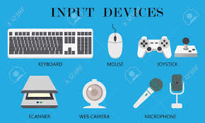
INPUT DEVICES:
Definition: Devices used to input data into a computer.
Examples: Keyboard, Mouse, Scanner, Microphone, Webcam.

Slide 4
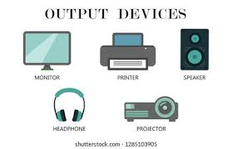
OUTPUT DEVICES:
Definition: Devices used to output data from a computer.
Examples: Monitor, Printer, Speakers, Projector.

Slide 5
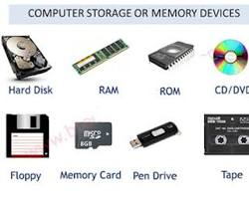
MEMORY DEVICES:
Definition: Devices used to store data.
Types: Primary Memory (RAM, ROM), Secondary Memory (Hard Disk, SSD, USB Drive).

Slide 6
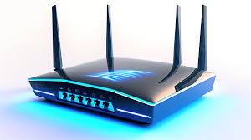
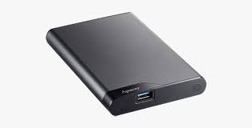
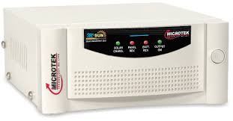
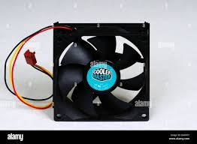
OTHER DEVICES:
Definition: Devices that do not fall strictly into input, output, or memory categories but are essential for the functioning and enhancement of computer systems.
Examples:
Network Devices: Routers, Modems, Network Cards.
Peripheral Devices: External Hard Drives, USB Hubs, Docking Stations.
Power Supply Units: UPS (Uninterruptible Power Supply), Surge Protectors.
Cooling Devices: Fans, Heat Sinks, Liquid Cooling Systems.

